Slide 1
Cornerstone City Church Peninsula Plus Community Hoo Are Ya 10-04-2022

Slide 2
Great Big God
CCLI Song # 3373437
Jo Hemming | Nigel Hemming
© 2001 Vineyard Songs (UK/Eire) (Admin. by Integrity Music Ltd)
For use solely with the SongSelect® Terms of Use. All rights reserved. www.ccli.com
CCLI Licence No. 33265

Slide 3
1/2
Our God is a great big God
Our God is a great big God
Our God is a great big God
And He holds us in His hands

Slide 4
2/2
He's higher than a skyscraper
And He's deeper than a submarine
He's wider than the universe
And beyond my wildest dreams
And He's known me and He's loved me
Since before the world began
How wonderful to be a part of
God's amazing plan

Slide 5
You Are Good
CCLI Song # 3383788
Israel Houghton
© 2001 Integrity's Praise! Music (Admin. by Integrity Music)
Sound Of The New Breed (Admin. by Integrity Music)
For use solely with the SongSelect® Terms of Use. All rights reserved. www.ccli.com
CCLI Licence No. 33265

Slide 6
1/3
Lord You are good And Your mercy endureth forever Lord You are good And Your mercy endureth forever People from every nation and tongue From generation to generation

Slide 7
2/3
We worship You Hallelujah hallelujah We worship You for who You are We worship You Hallelujah hallelujah We worship You for who You are For You are good

Slide 8
3/3
You are good all the time All the time You are good You are good all the time All the time You are good

Slide 9
Mighty to Save
CCLI Song # 4591782
Ben Fielding | Reuben Morgan
© 2006 Hillsong Music Publishing Australia (Admin. by Hillsong Music Publishing UK)
For use solely with the SongSelect® Terms of Use. All rights reserved. www.ccli.com
CCLI Licence No. 33265

Slide 10
1/4
Ev’ryone needs compassion
Love that's never failing
Let mercy fall on me
Ev’ryone needs forgiveness
The kindness of a Saviour
The hope of nations

Slide 11
2/4
Saviour He can move the mountains
My God is mighty to save
He is mighty to save
Forever Author of salvation
He rose and conquered the grave
Jesus conquered the grave

Slide 12
3/4
So take me as You find me
All my fears and failures
Fill my life again
I give my life to follow
Ev’rything I believe in
Now I surrender

Slide 13
4/4
Shine your light and let the whole world see
We're singing
For the glory of the risen King
Jesus
Shine your light and let the whole world see
We're singing
For the glory of the risen King

Slide 14
Your Name
CCLI Song # 4611679
Glenn Packiam | Paul Baloche
© 2006 Integrity Worship Music (Admin. by Integrity Music Ltd)
Integrity's Hosanna! Music (Admin. by Integrity Music Ltd)
For use solely with the SongSelect® Terms of Use. All rights reserved. www.ccli.com
CCLI Licence No. 33265

Slide 15
1/4
As morning dawns and evening fades
You inspire songs of praise
That rise from earth to touch Your heart
And glorify Your Name

Slide 16
2/4
Your Name is a strong and mighty tower
Your Name is a shelter like no other
Your Name let the nations sing it louder
'Cause nothing has the power to save
But Your Name

Slide 17
3/4
Jesus in Your Name we pray
Come and fill our hearts today
Lord give us strength to live for You
And glorify Your Name

Slide 18
4/4
Your Name is a strong and mighty tower
Your Name is a shelter like no other
Your Name let the nations sing it louder
'Cause nothing has the power to save
But Your Name

Slide 19
Where Would I Be
CCLI Song # 7171115
Casey Brown | Hope Darst | Katelyn Marks
© 2021 Fair Trade Global Songs (Admin. by / Small Stone Media BV, Holland (Admin. in the UK/Eire by Song Solutions www.songsolutions.org))
Hope For The Best Songs (Admin. by / Small Stone Media BV, Holland (Admin. in the UK/Eire by Song Solutions www.songsolutions.org))
Katelyn Marks Publishing Designee (Admin. by Capitol CMG Publishing)
TBCO Publishing (Admin. by Capitol CMG Publishing)
Remaining portion is unaffiliated
For use solely with the SongSelect® Terms of Use. All rights reserved. www.ccli.com
CCLI Licence No. 33265

Slide 20
1/5
Your hand in every part
Of my whole life from the start
Jesus You, have always been with me
No matter where I was
You found a way to show up
Jesus You, have always been with me

Slide 21
2/5
There's never a season never a place
Where I am alone where You don't show Your face
Right here I remember how could I forget
Your faithfulness has never left me

Slide 22
3/5
Where, would I be without You
Where, would I be without Your love
I am amazed by all you have done
Where, would I be without You
Where, would I be without Your love
Lord, I can’t say Thank You enough

Slide 23
4/5
All of the ways You save
Pull me out of the grave
Jesus You, have always been for me
Oh my life is the proof
That You can make anything good
Jesus You, have always been for me

Slide 24
5/5
Thank You, Thank You
Thank You, Thank You
Thank You, Thank You
For all you have done
I want to say Thank You, Thank You
I have to say Thank You, Thank You
I got to say Thank You, Thank You
For all you have done

Slide 26


Slide 27


Slide 28


Slide 29


Slide 30
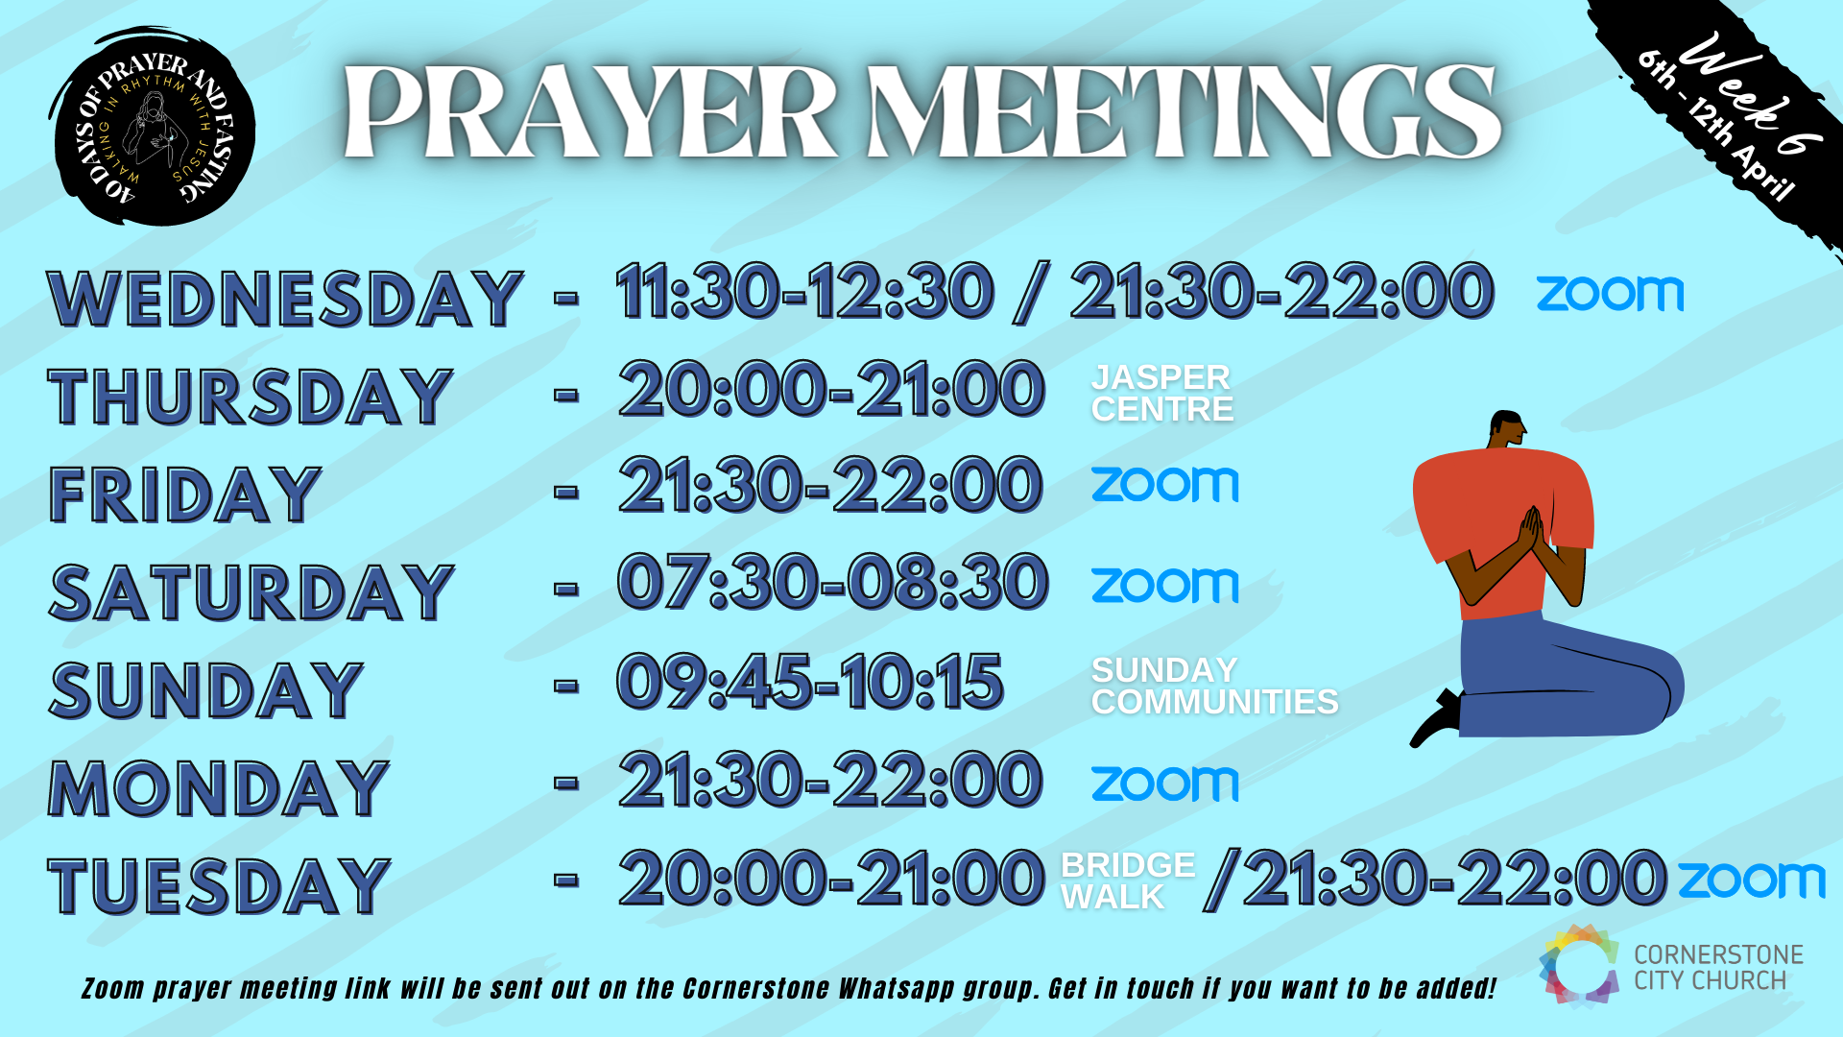

Slide 31


Slide 32


Slide 33


Slide 34


